Slide 1






SciTech Innovation Hackathon - 2025
College : Pratibha Institute Of Business Management
Project Details
Project Name : SkillChain
Problem Statement : 8.1 Peer-to-Peer Skill Validation Platform
Team Details
Team Name : PIBM CodeClan
Members
Om Nimmalwar
Mca 1st year
7741802880
omnimmalwar32@gmai.com
AbdulHannan Shaikh
Mca 1st year
8459279029
hannanbshaikh1304@gmail.com
Devki Salvi
Mca 1st year
9322063509
devkisalvi2012@gmail.com
Sahil Sawant
Mca 1st year
7276207952
sahilsawant7276@gmail.com

Slide 2
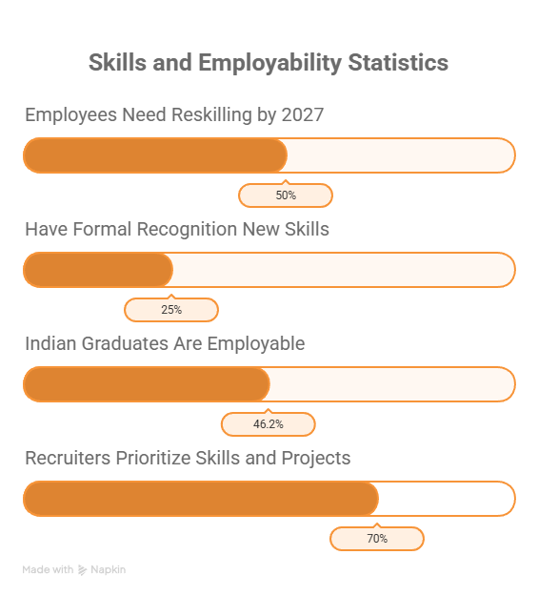
Problem Statement
Problem:
In today’s fast-changing world, many individuals possess practical, creative, and soft skills that go unrecognized because traditional certificates focus only on theory.
As a result, talented people often struggle to prove their real abilities to employers and organizations.
Importance:
This project addresses the need for a peer-to-peer validation platform where users can demonstrate skills, receive authentic endorsements, and gain recognition through verified digital badges.
Supporting Facts:
Only 46% of Indian graduates are employable due to lack of practical exposure (India Skills Report, 2024).
70% of recruiters now value skills over degrees (LinkedIn, 2023).
50% of employees will need reskilling by 2027 (World Economic Forum, 2024).

Slide 3
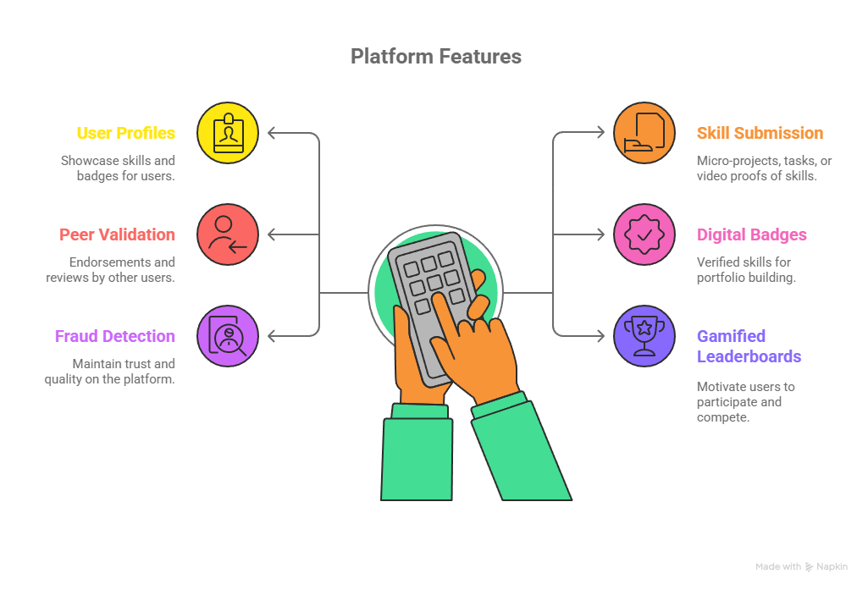
Proposed Solution
Purpose / Idea:
Create a peer-to-peer platform where people can show their skills through small projects or video proofs , and get verified by the community. Verified skills are recorded as digital badges for future recognition.
How It Solves the Problem:
Provides real recognition for practical, soft, and creative skills.
Uses peer validation to ensure fairness and authenticity.
Helps employers, clients, and peers identify true talent.
Key Features / Functionalities:
User Profiles – showcase skills and badges.
Skill Submission – micro-projects, tasks, or video proofs.
Peer Validation – endorsements and reviews by other users.
Digital Badges / Skill Bank – verified skills for portfolio building.
Fraud Detection & Moderation – maintain trust and quality.
Gamified Leaderboards – motivate users to participate.
.

Slide 4
Innovation And Uniqueness
What Makes This Idea Different ?
1. Peer-Driven Validation
Skills are verified by real users, not just certificates or automated tests.
Encourages a community-based trust system.
2. Hands-On Skill Proof
Users submit micro-projects, tasks, or video demonstrations.
Focuses on practical ability, not theory alone.
3. Gamification & Motivation
Leaderboards, badges, and points engage users and reward participation.
Makes skill development fun and interactive.
Business Innovation Points
New Market Opportunity
Targets unrecognized talent in India and globally (students, freelancers, self-learners).
Skill Monetization
Verified skills can be used for freelancing, job applications, or micro-task platforms.
Community-Driven Trust
Reduces dependency on formal institutions; relies on peer validation, lowering operational costs.
Brand Differentiation
Novel and first-of-its-kind platform in India for practical skill recognition.

Slide 5
Potential Impact & Target Users
Target Users :
Students & Graduates: Showcase skills beyond formal degrees.
Freelancers & Creatives: Gain credibility for work done independently.
Job Seekers: Increase employability through verified skills.
Employers & Recruiters: Identify authentic talent efficiently.
Training Institutes & Educators: Track and validate student progress.
Expected Positive Outcomes:
Social Impact:
Recognizes hidden talents and promotes inclusive skill development.
Encourages a community-driven learning and validation culture.
Technical Impact:
Introduces a digital, gamified, and peer-validated system for skill recognition.
Ensures secure, scalable, and reliable skill validation.
Commercial / Business Impact:
Opens a new market for skill verification platforms.
Enables career opportunities, freelancing, and partnerships with educational institutions.
Supports digital credentialing and potential monetization of verified skills.

